Slide 1
JUST WAR

Slide 2
Morality and War
Is war ever justified?
Is war always justified?
Once a state of war exists, are there some actions that are morally justified and others not?
Does it make sense to talk about moral and immoral actions in a war?

Slide 3
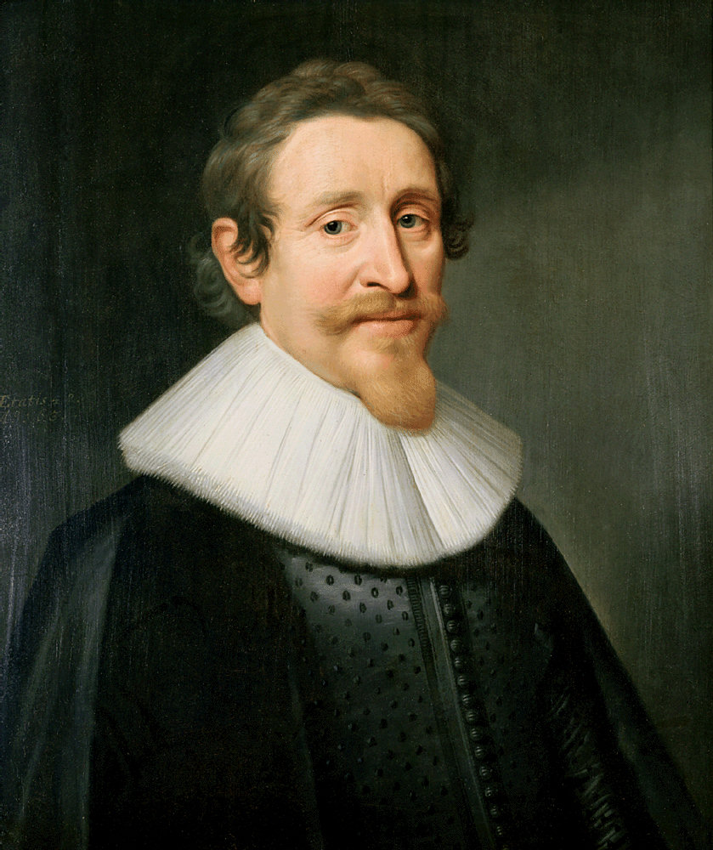
Hugo Grotius and War
He who wills the attainment of a given end, wills also the things that are necessary to that end. God wills that we should protect ourselves, retain our hold on the necessities of life, obtain that which is our due, punish transgressors, and at the same time defend the state… But these divine objectives sometimes constitute causes for undertaking and carrying on war… Thus it is God's Will that certain wars should be waged… Yet no one will deny that whatsoever God will, is just. Therefore, some wars are just.

Slide 4
Motives
STATE MORALIST
Defensive v. aggressive wars
Question of preemption v. prevention.
Examples: Desert Storm (Iraq 1991)
1967 Six Day War
Operation Iraqi Freedom (2003)
REALIST
Does it maintain system stability/balance of power?

Slide 5
Means
Have peaceful alternatives been exhausted?
Are you using forcing against soldiers or civilians?
Is it proportionate?

Slide 6
Consequences
Is there a reasonable chance of success? Is there a likelihood that what the war achieves will outweigh its human cost?

Slide 7
EXAMPLES
September 11, 2001 Attack
U.S. Invasion of Afghanistan (2001)
US war on ISIS (2014)

